Slide 1
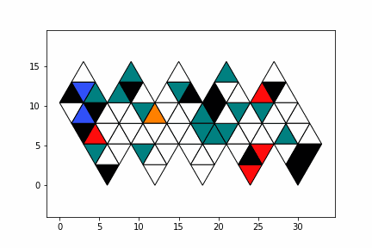
Novel Chemical Structure Input Method
Ella M Gale: ella.gale@bristol.ac.uk

Slide 2
Overall Motivation
We want to apply machine learning (artificial intelligence) to chemistry
But,
The big advances in ML have been focussed on specific problem domains, like image recognition and text parsing
Chemical problems are a very different domain set,
Therefore we cannot blindly apply standard ML and expect results
We need to look at how ML has dealt with issues it has faced and apply those lessons in a domain appropriate manner
e.g. we don’t use the data augmentation of standard ML as it is not suitable, but we do use the approach of data augmentation, and we must develop chemically relevant data augmentation.
We need to use our chemical knowledge to formulate the problems in the easiest way for the algorithm to solve.

Slide 3
Problems unique to applying AI/ML to chemistry
Image/text data*
Chemical data
Many labeled examples
Complete data
Can use data augmentation
New data easy to find
Data ‘free’ on internet
(actually ‘stolen’ from flickr)
Few labeled examples
Incomplete data
Can’t use data augmentation
New data involves lab work
Some data often behind paywall, in private databases or in old textbooks
* Types of data ML (esp. neural networks) has had huge success with

Slide 4
Motivation 1: 3D shape is important
Problem | Importance of chirality / 3D shape to solution | Types of algorithms used for solution
Suggesting target molecules | Critical | (quantum mechanics, molecule mechanics)
De novo drug design | Critical | Neural networks, clustering, search, generative
Forward reaction prediction | Medium (needs to be tracked) | Neural networks, general ML, search
Retrosynthesis | High (needs to be tracked) | Search, neural networks
Condition recommendation | Low | Search, neural networks
Structure assignment | Critical | General ML, neural networks,

Slide 5
Motivation 2: Chemical data is small
Small compared to chemical space

Slide 6
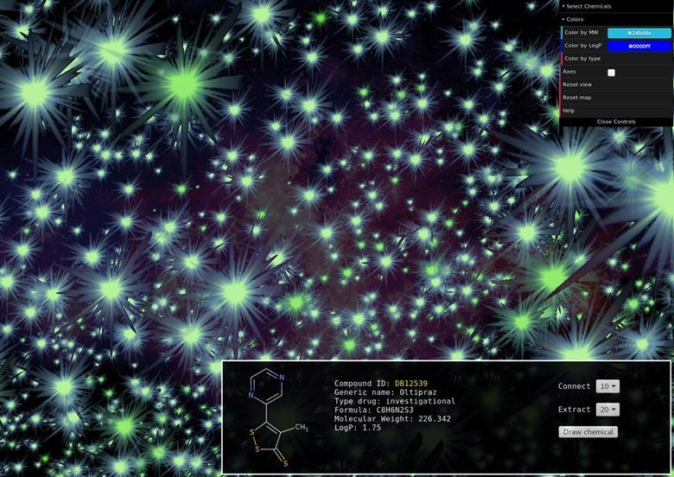
10⁶⁰
Chemical Space
Potential Pharmacological molecules possible
Image source: © Alexandre Borrel, PhD
The ChemMaps tool allows the user to visualise a structure as a star within a galaxy of other compounds whose closeness reflects their structural similarity see ChemMaps.com

Slide 7
<0.000000001%
Chemical Space
Of Possible Molecules Have Been Synthesised
Source: © Alexandre Borrel, PhD
The ChemMaps tool allows the user to visualise a structure as a star within a galaxy of other compounds whose closeness reflects their structural similarity

Slide 8
Motivation 2: Chemical data is small
Small compared to chemical space
Small compared to datasets used successful in ML

Slide 9

Data Used In Visual Classification Tasks: Benchmark
MNIST:
Input data: greyscale 28x28 pixel image
No. Classes = 10
No. Examples:, 60,000
No. examples per class: 6000

Slide 10
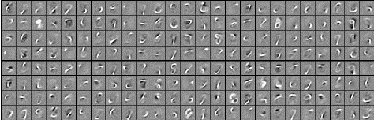
The MNIST TAsK is ‘understandable’
MNIST:
Learned features
Fried, Ohad, and Rebecca Fiebrink. "Cross-modal Sound Mapping Using Deep Learning." NIME. 2013.

Slide 11
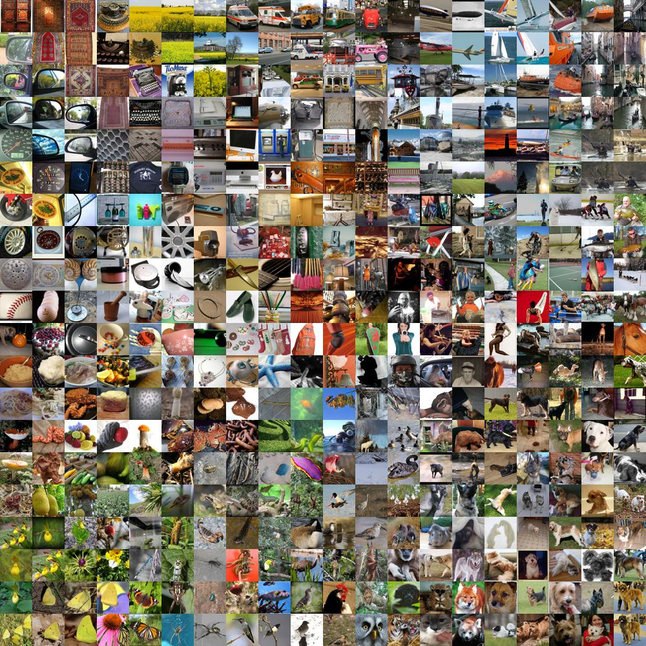
Data Used In Visual Classification Tasks
IMAGENET:
Input data: colour 244x244 pixel image
No. Classes = 1000
No. Examples:, 1,300,000
No. examples per class: 1,300

Slide 12
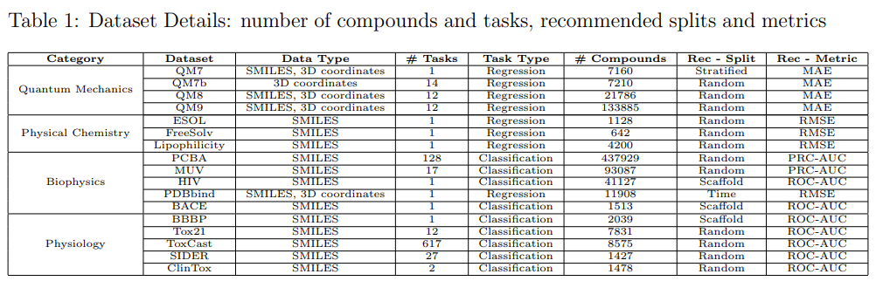
MoleculeNET: Chemical Benchmarks
Size of Chemical Benchmark Datasets:
Min: 642
Max: 437,929
Average: 7210 \Pm 26,071.9
Size of visual benchmark datasets
MNIST: 60,000
cats versus dogs:25,000
Size of IMAGENET: 1,300,000
Taken from: Wu, Zhenqin, et al. "MoleculeNet: a benchmark for molecular machine learning." Chemical science 9.2 (2018): 513-530.

Slide 13



Solution to small datasets: Data Augmentation
Original
Reflection
Visual data augmentation
Crop
Rotation
Reflection!
Rotation
Crop

Slide 14
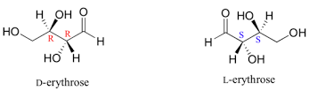
Solution to small datasets: Data Augmentation
Visual data augmentation
Crop
Rotation
Reflection!
Reflection
But how would this work with molecules???
Rotation
Crop

Slide 15
Premise:
Encode the 3D structure and symmetry properties
Use deep-neural networks (NNs)
Add in data augmentation
We need a simpler benchmark tasks!

Slide 16
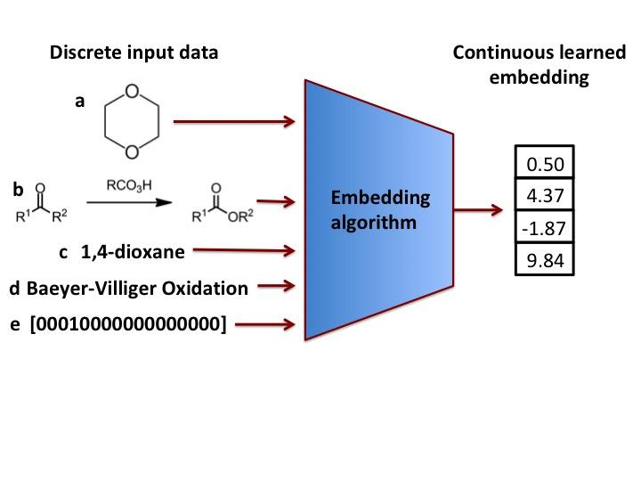


Encoding Chemicals
2D
(Usually a
Neural
network)
1D
f. SMILES: C1COCCO1
1D
See:
[1] E. Gale & D. Durand, “Improving Reaction Prediction, Nature Chemistry, 12, 509-510 (2020)”
[2] G. Grethe et al,, ““International chemical identifier for reactions” (RInChI)”, J. Cheminformatics, “ (2018)
[3] Graphical representation standards for chemical reactions (IUPAC Recommendations 2019), L.S. Press, J.B. Press, K.T. Taylor
.

Slide 17
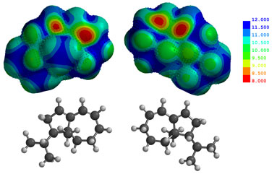
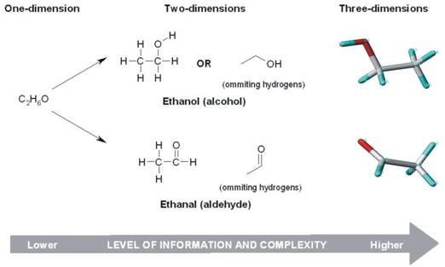
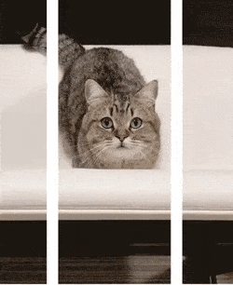
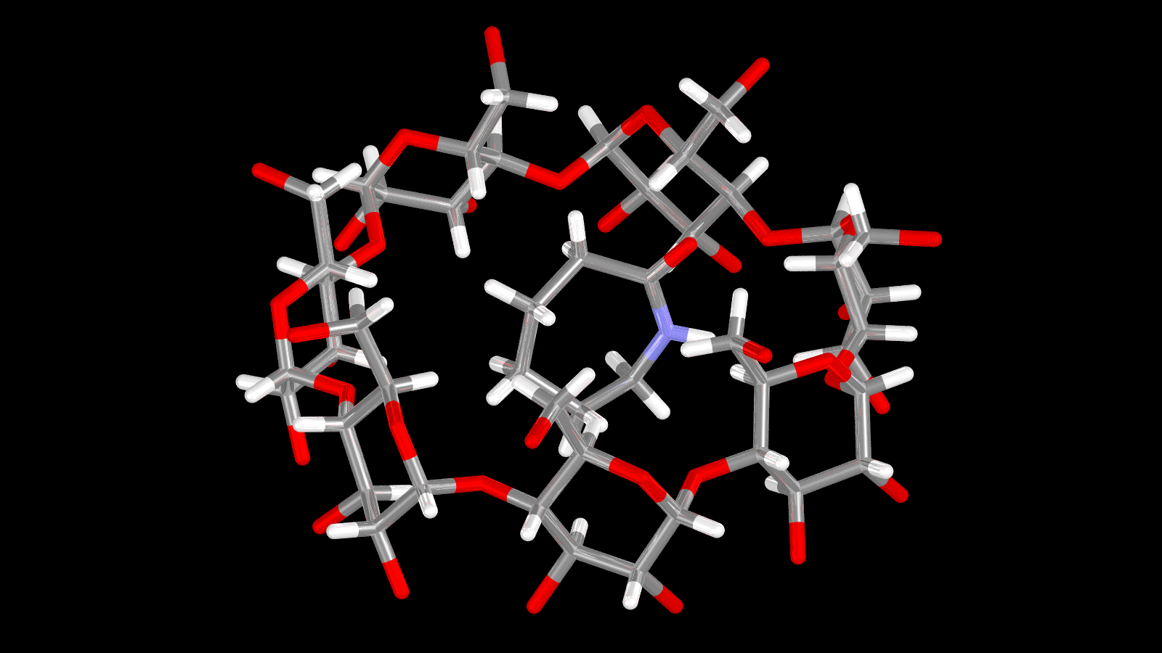
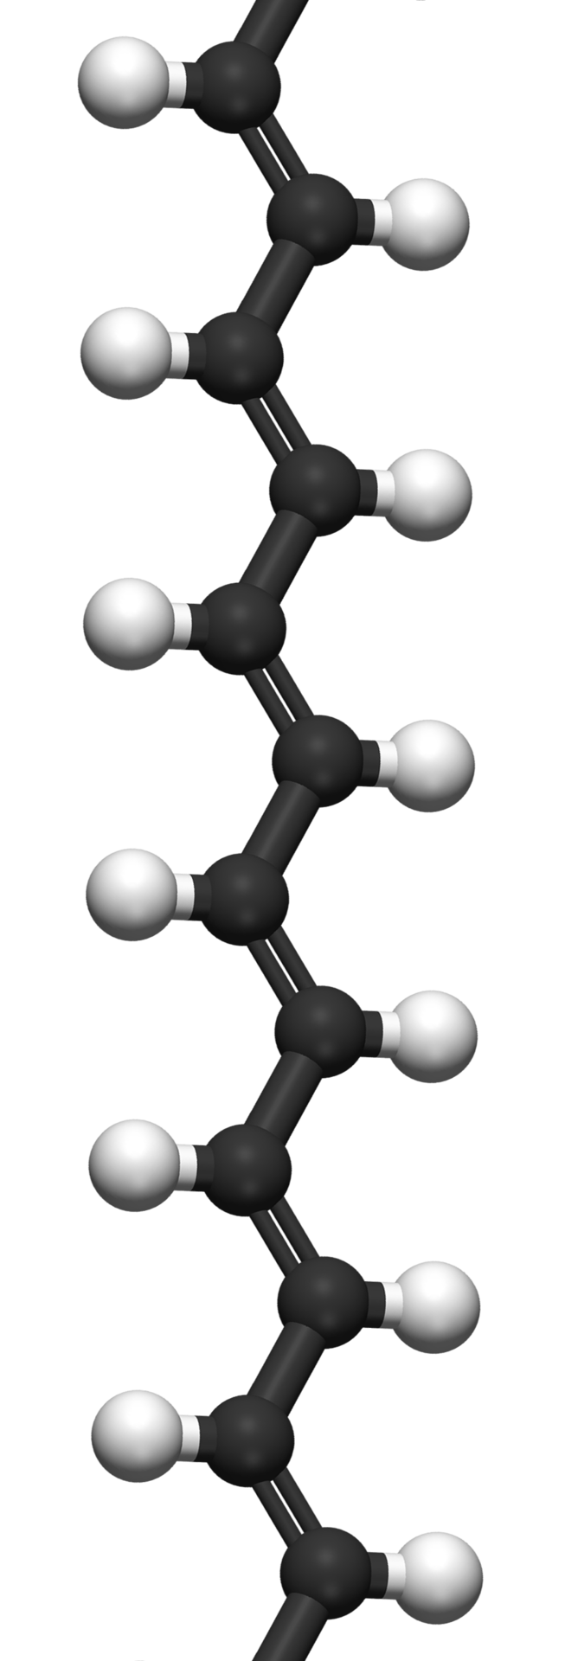
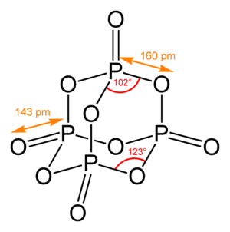
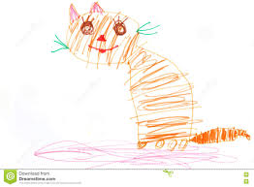
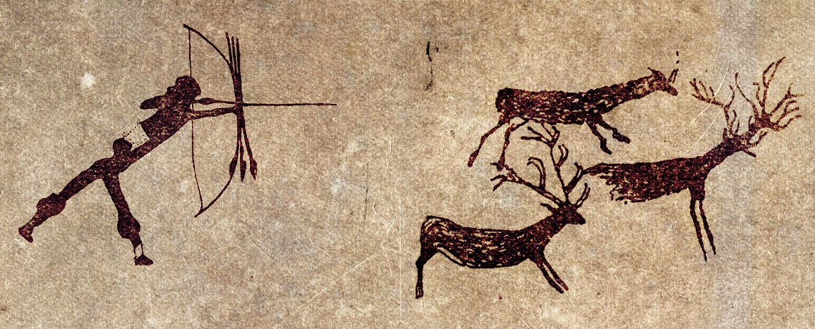


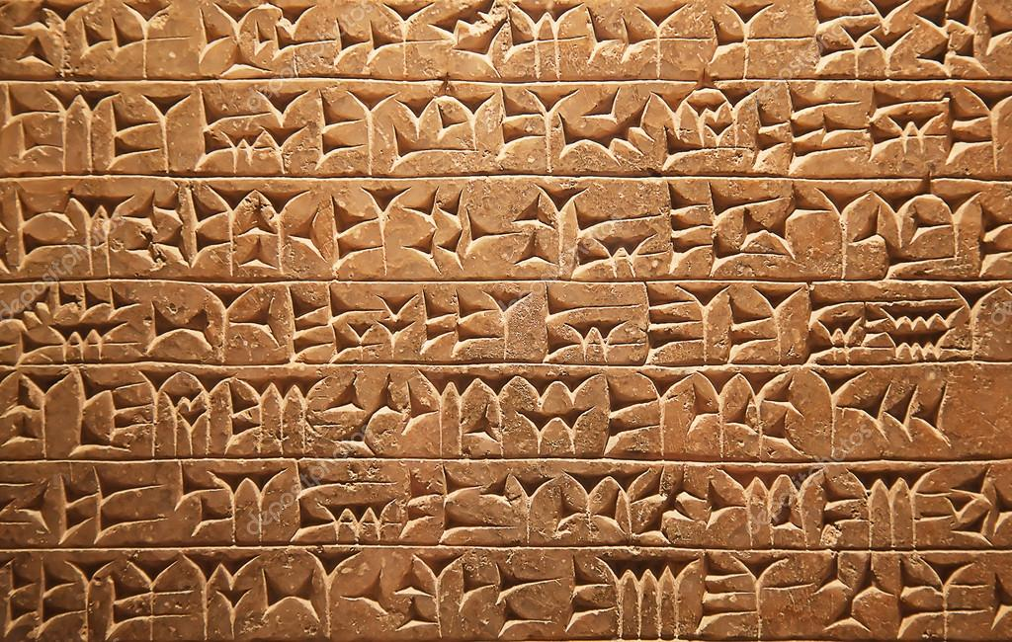
How difficult is the problem?
Data type | Human | Humanity | Chemistry
3-D | ~6 months | -infinity!
2-D | ~18 months | 30,000 BCE
1-D and symbolic | ~3-4 years | 3400 BCE | C1COCCO1 C2H5OH Ethanol CAS 639052-78-1 [0000010100001100 … 0]

Slide 18
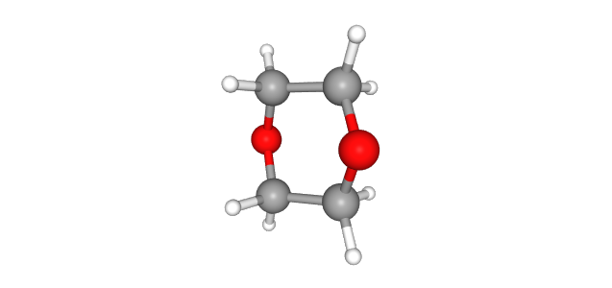
Encoding Chemicals (New)
Input
Problems:
1. We want to retrain 3D structure for chirality
2. Deep-NNs have had the most success with 2D image data
3. We need lots of data for NNs to learn (data augmentation).
4. Data augmentation is usually done using reflection (not appropriate for chemistry
.
3D input can be used with spherical or 3D neural nets.
3D structure
3D input can be converted to a novel 2D input that retains rotational symmetry and chirality.
This will allow a speed-up compared to 3D NNs

Slide 19
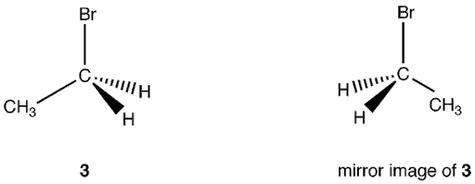
Symmetry, rotation, augmentation
Using different rotations of a molecule is acceptable augmentation
Using reflection operations is not
We need to preserve:
Rotational symmetry
Chirality
Global structure
Translational invariance

Slide 20
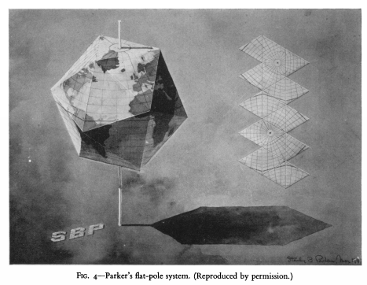
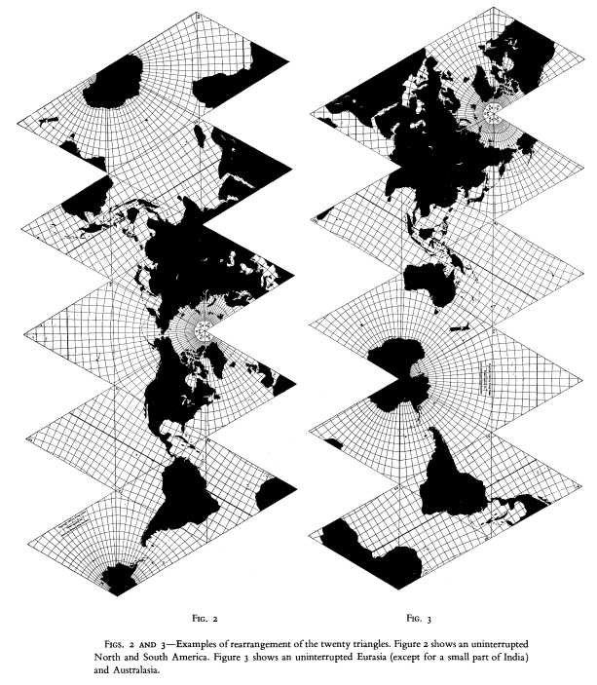
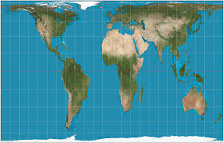
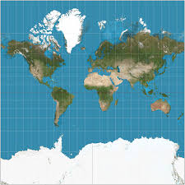
Icosahedrons offer the smallest distortion when going from 3D to 20
Icosahedron (icosphere level 0)
Icosahedron nets
Irving Fisher. A world map on a regular icosahedron by gnomonic projection. Geographical Review, 33(4):605–619, 1943

Slide 21
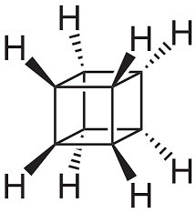
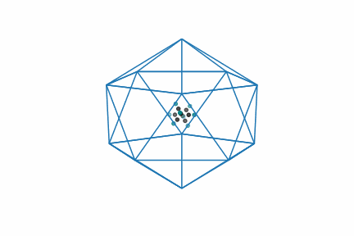
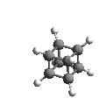
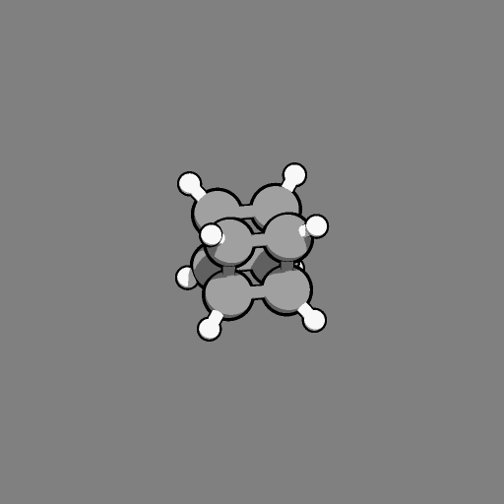
1. Encapsulate molecule in an icosahedron

Slide 22
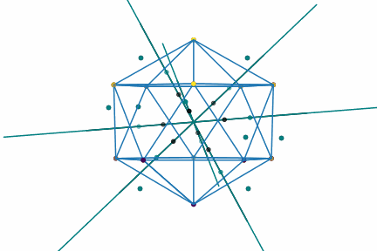
Scale and project atoms from centre of mass to surface of icosahedron

Slide 23
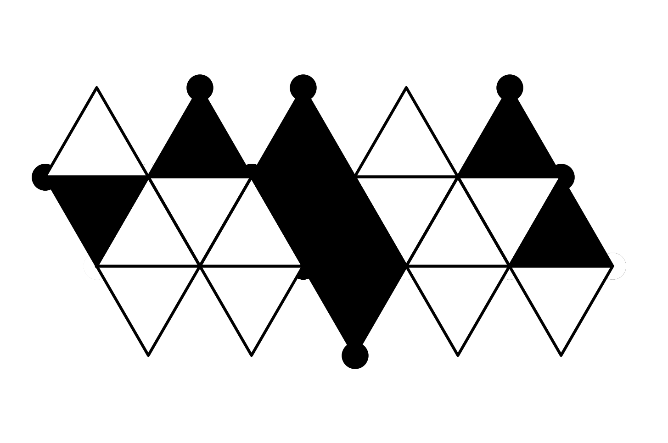



Colour panels of icosahedron and Unfold
There are 60 possible nets. Hydrogens not shown

Slide 24
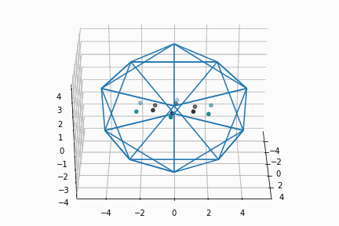
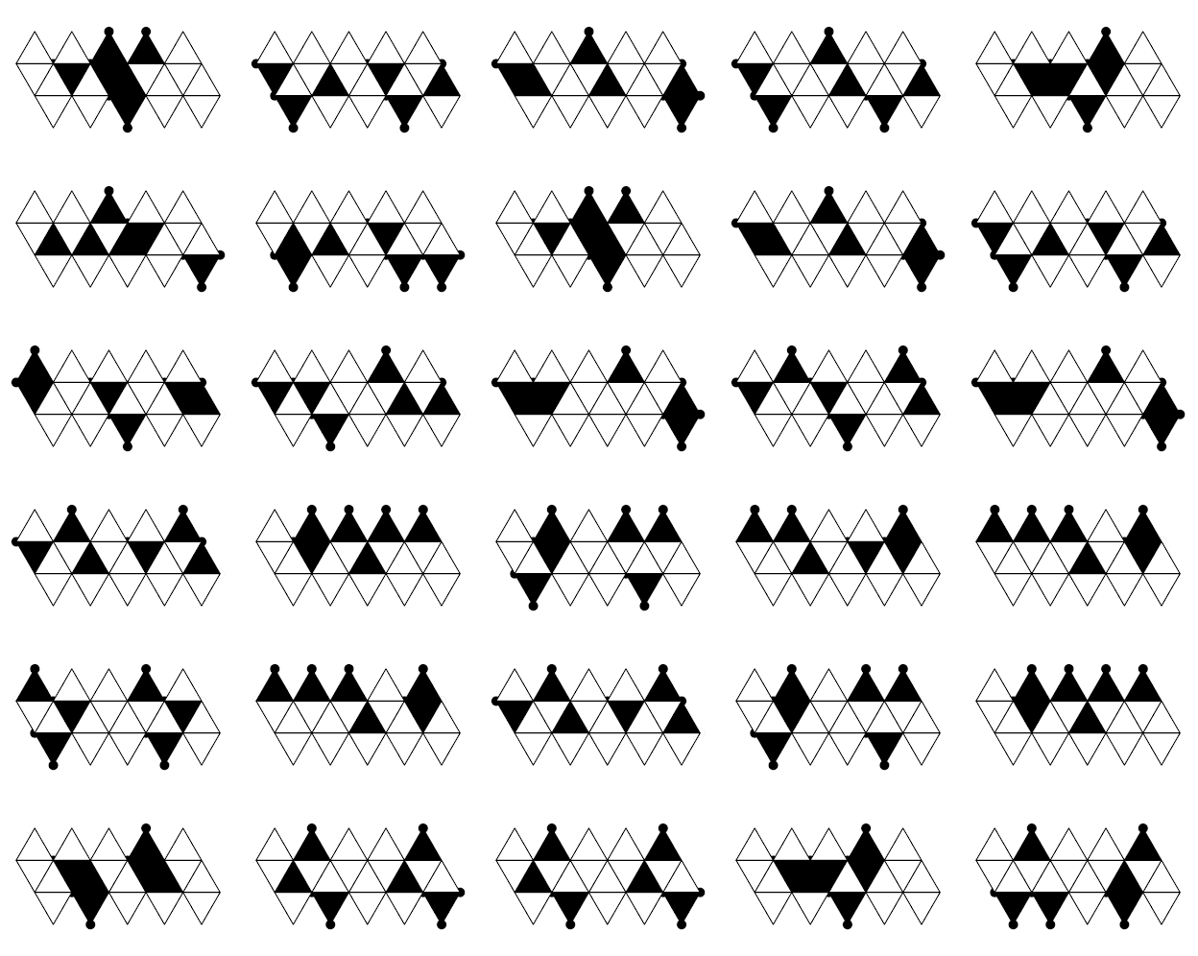
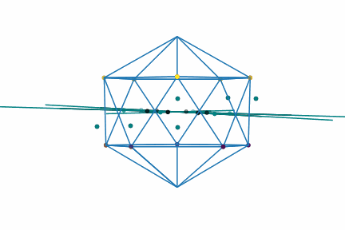
Encod Benzene
Input
Nets (unfoldings)

Slide 25
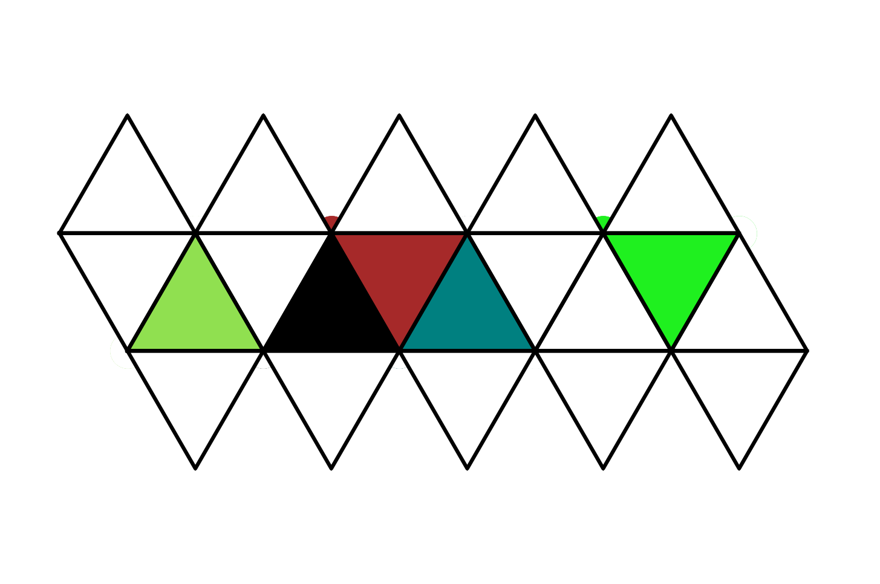
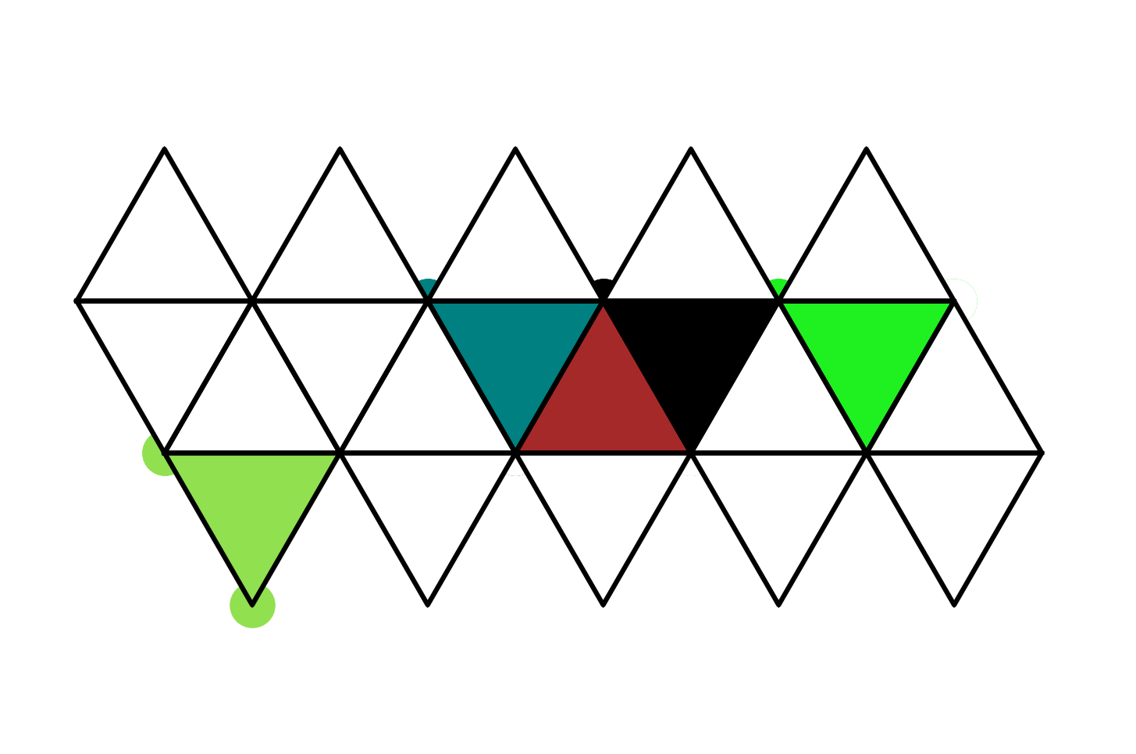
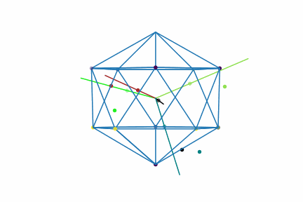
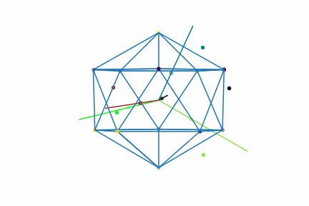
enantomers
R-BClFmethane
S-BClFmethane

Slide 26
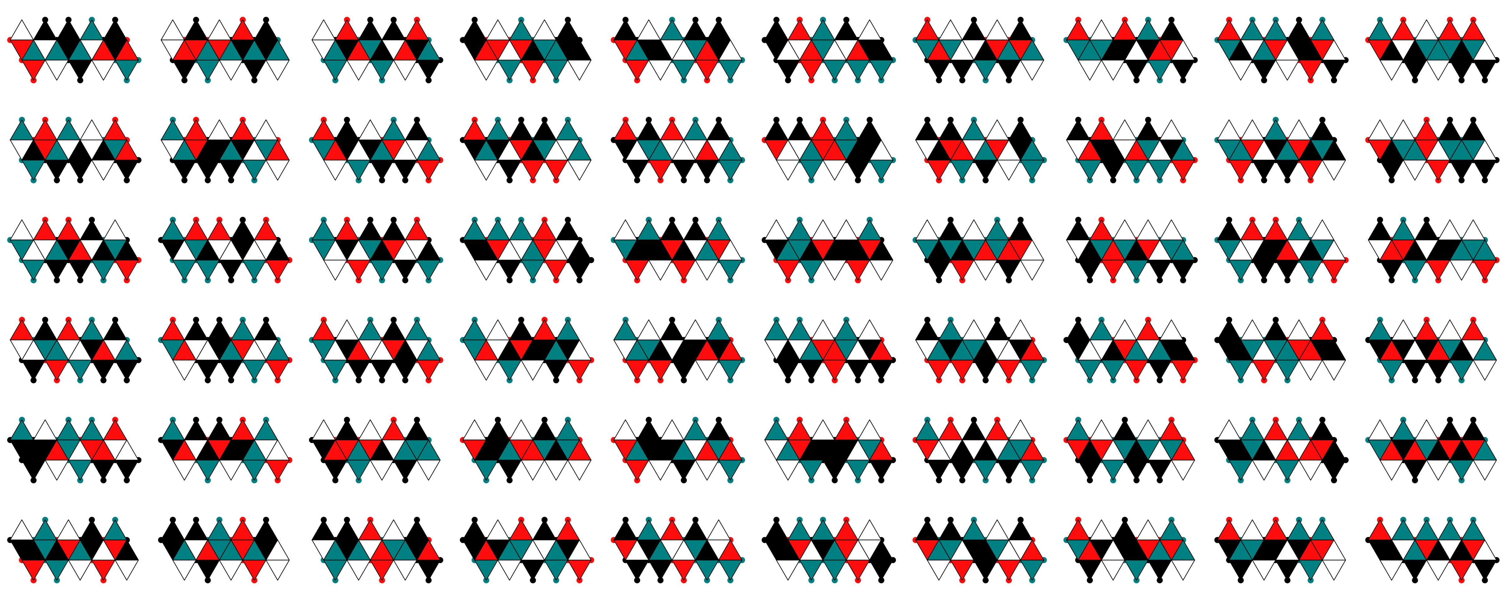
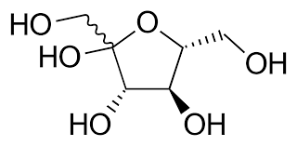
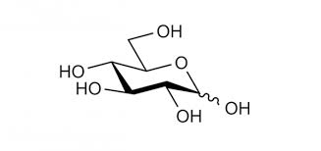
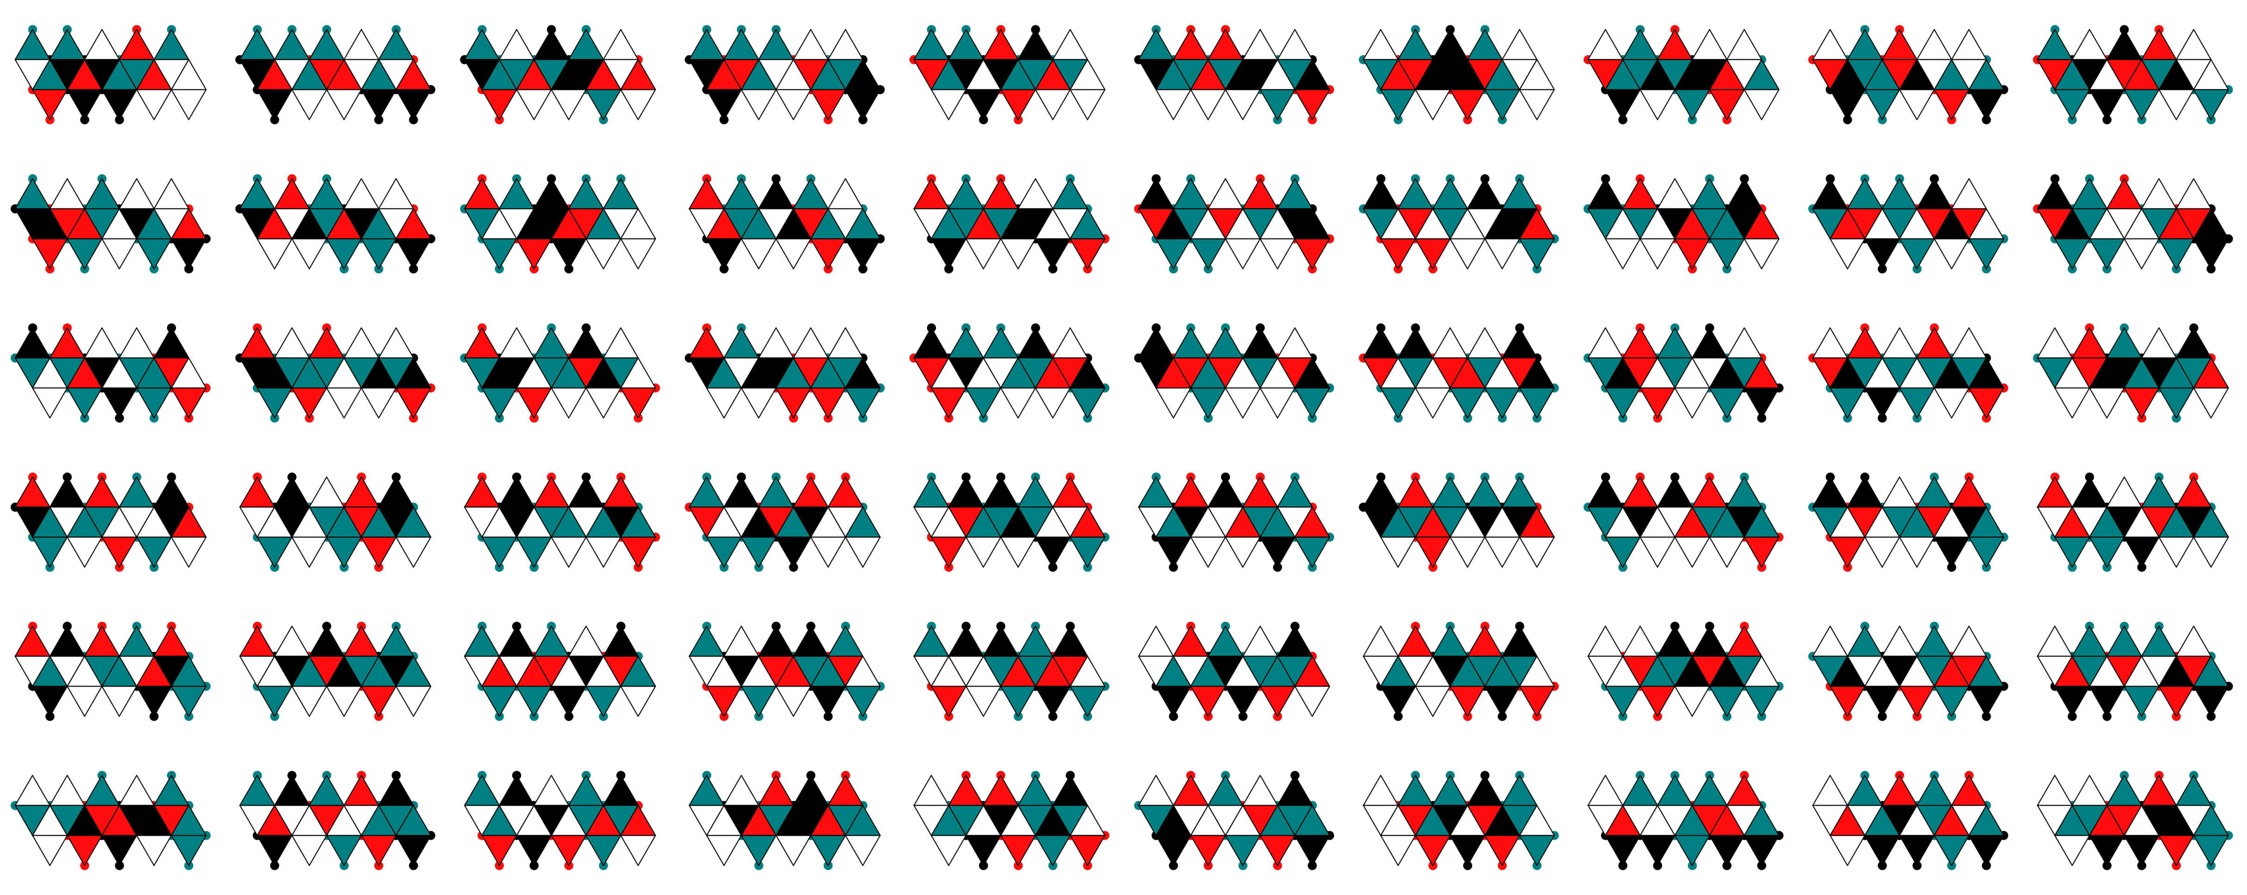
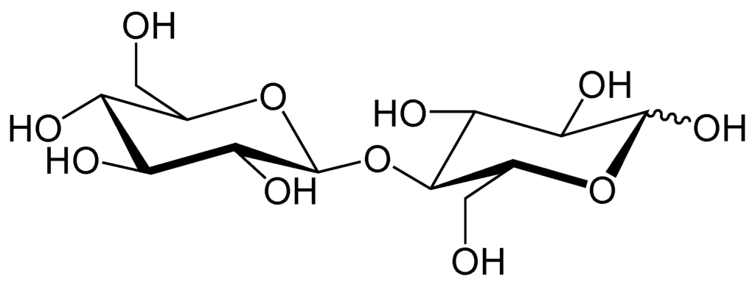
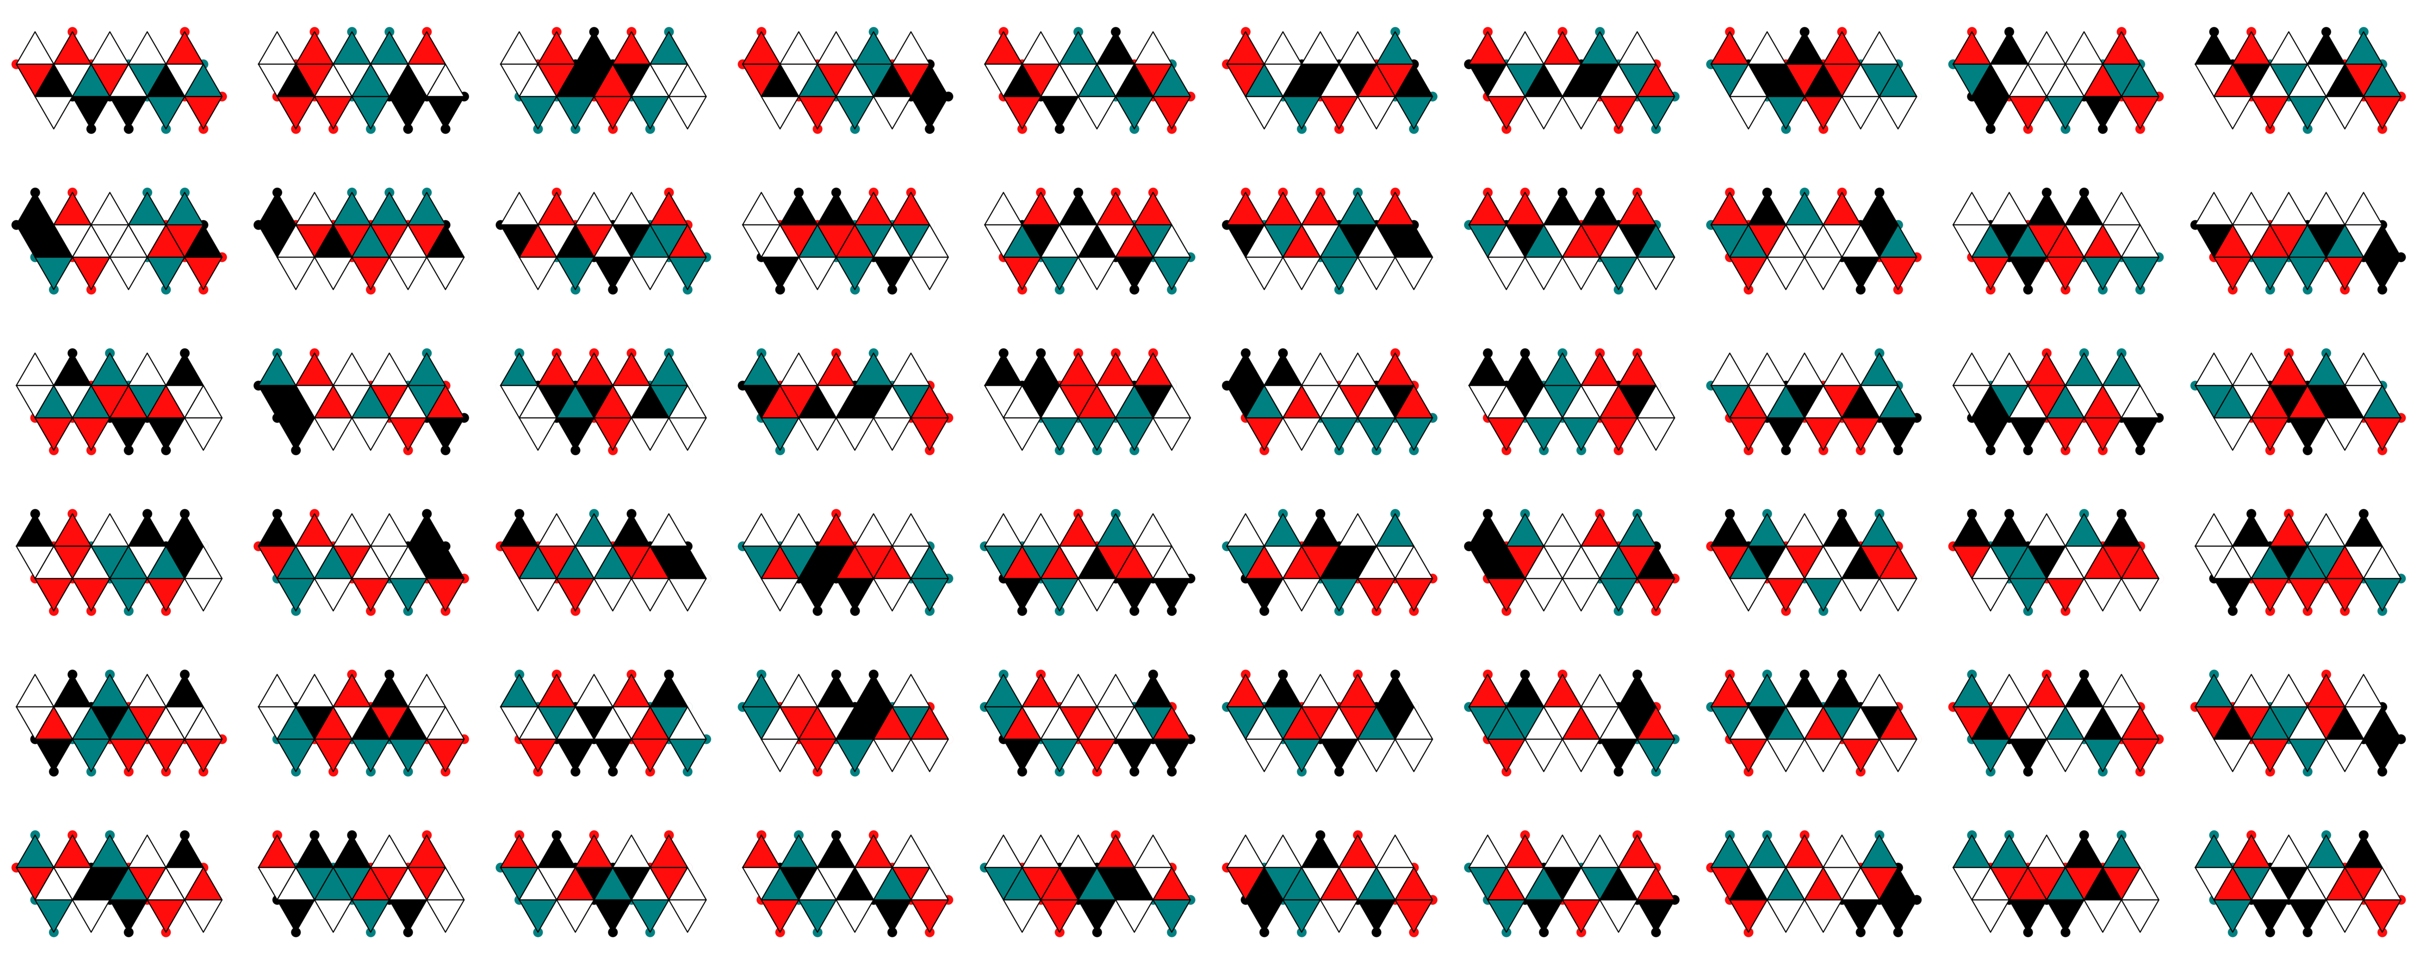
Sugar example
Fructose
Glucose
Cellubiose

Slide 27
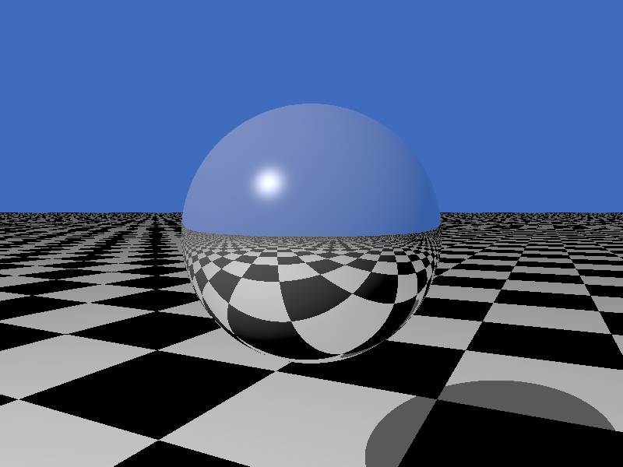
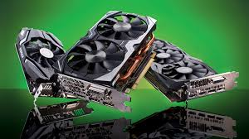
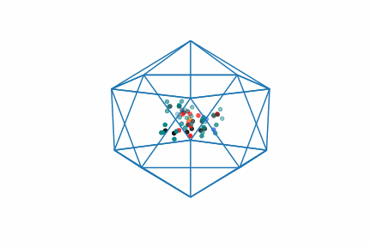
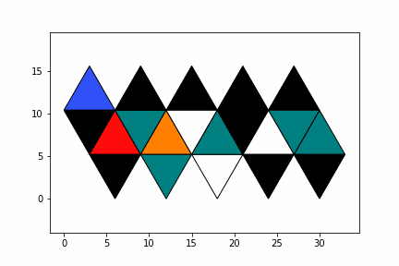
Encoding Chemicals (New!)
Input
Icosahedron
Tamiflu
Icosphere 1
Icosphere 1
Icosahedron

Slide 28
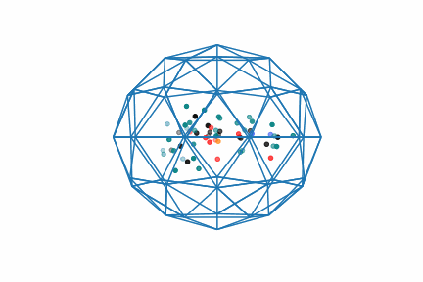
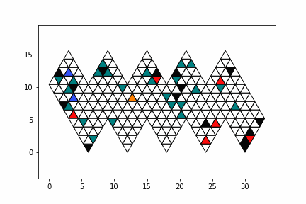
Coarse-graining
Input
Tamiflu
Icosphere 1
Icosahedron
Icosphere 1
Icosahedron
Icosphere 2

Slide 29
methodology
(Preliminary)

Slide 30
Types of Deep neural network tasks and architecture
Classification
Regression
Autoencoder
Input
Neural network
Neural network
Neural network
o
output
1
0.01
2.5634
0.1
0.89
0.1
0.01
0.89
Ground truth
(correct answer)
0.0
0.0
1.0
2.6102
Neural network
Radius of
gyration
[0,0,1] = alcohol
output
Interpretation

Slide 31
Experimental Architectures
Set-Up
Control
SMILES string
3D-Structure (minimised)
Icosphere nets
Spherical NN
Output target
SMILES string
Morgan fingerprint (binary data)
Neural network
Output target

Slide 32
Experimental details
Data sets
Testing
Molecular ID:
10% of nets per molecule taken as test set
Everything else:
10% of molecules taken as test set
Generalisation to new molecules
(has the NN learned the general rule?)
a. 1000 nets for 1000 molecules
60,000 nets for 1000 molecules
Icospheres level 1, 2 and 3 tested

Slide 33
Actual input data is:
RGB where
R = mass of inner most atom
G = mass of outer most atom
B = sum of atom masses
Eg:
C-H is
[12.0107, 1.0078, 13.0185]
C=O is
[12.0107, 15.999, 28.0097 ]
O-H is
[15.999, 1.0078, 17.0068]

Slide 34
Difficulty of pRoblem
Also:
Problems can be hard because the NN is underpowered or the dataset is too small
e.g.:
Classifying 1000 classes from 60,000 datapoints is harder than classifying 10 classes from 60,000 data points
EASY:
Entirely easily derivable from input data only.
(Ella can figure out the rules to do it in under 5 minutes) e.g. counting atom types, summing atomic mass
MEDIUM:
Requires some chemical knowledge that might not be given
e.g. counting valence electrons, learning what a heteroatom is (to count them) counting H donors etc
HARD:
Requires a spatial, electronic or quantum knowledge
e.g. calculating shape parameters like principal moments of inertia (and derived quantities like…) MolLogP

Slide 35
RESULTS
(Preliminary)

Slide 36
Has It learned to ‘read’ the Nets?
Task: classification / autoencoder
Level: hard
Input data:
Input no: 1000 / 60,000
Level: 2
No. classes: 1000
Output target:
ID number
Test set: unseen nets
Training details:
Epochs: 160
Task | Augmentation | Acc. On train | Acc. On test
Random (baseline) | n/a | 0.1% | 0.1%
Classification | no | 100% | 1%
Classification | yes | 100% | 60%
Conclusion:
Yes. But it can only differentiate 60%of them.

Slide 37
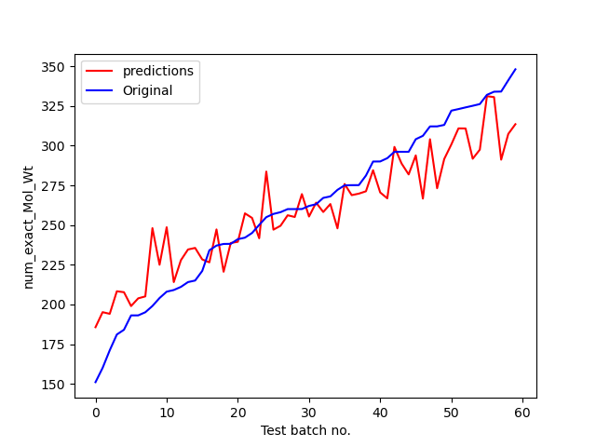
Effect of Augmentation 1: Without augmentation
Task: regression
Level: easy
Input data:
Input no: 1000
Level: 2
Augmentation: no
Output target:
Exact molar weight
Test set: unseen molecules
Results:
R² = 0.812
MSE = 580
Training details:
Epochs: 60
Plotted: test set

Slide 38
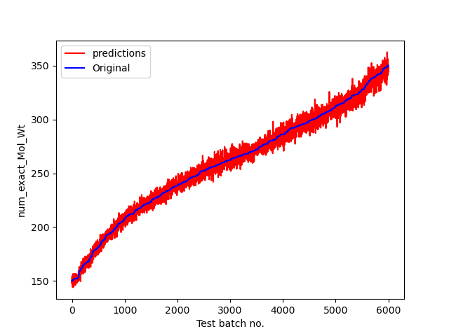
Effect of augmentation: With augmentation
Task: regression
Level: Easy
Input data:
Input no: 1000
Level: 2
Augmentation: yes
Output target:
Exact molar weight
Test set: unseen molecules
Results:
R² = 0.979
MSE = 23
Training details:
Epochs: 60
Plotted: test set

Slide 39
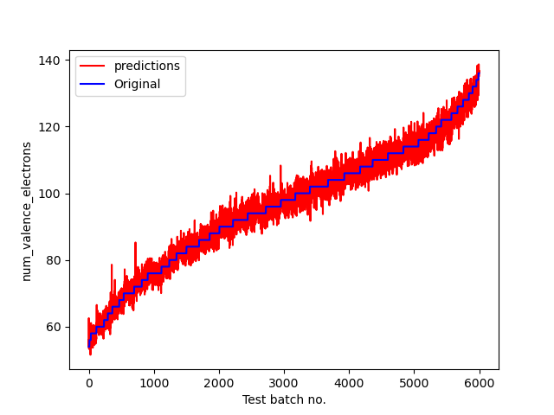

Effect of augmentation: With augmentation
Task: regression
Level: Medium?
Input data:
Input no: 1000
Level: 2
Augmentation: yes
Output target:
Number of valence electrons
Test set: unseen molecules
Results:
R² = 0.9824
MAE = 21.9
Training details:
Epochs: 160
Plotted: test set

Slide 40


Can It learn Shape parameters? (i.e. those based on moments of inertia)
Task: regression
Level: hard
Input data:
Input no: 1000
Level: 2
Augmentation: yes
Output target:
Radius of gyration
Test set: unseen molecules
Results:
R² = 0.886
MAE = 0.138
Training details:
Epochs: 160
Plotted: test set

Slide 41
Match the input data to the problem - 1
Task: regression
Level: hard
Input data:
Input no: 1000 / 60,000
Level: 2
Output target:
Radius of gyration
Test set: unseen molecules
Training details:
Epochs: 160
Input | Output | Augmentation | Difficulty | MAE | R2
SMILES | Radius of gyration | no | Hard-impossible? | 1.1 | -0.1167
Icosphere level 2 | Radius of gyration | no | medium | 0.258 | 0.667
Icosphere level 2 | Radius of gyration | yes | medium | 0.138 | 0.886
Nets contain mass and relative angle information → NN can infer about shape
SMILES strings do not contain shape information (without the application of chemical know how anyway) → NN cannot learn the underlying function

Slide 42
MATCH the INPUT DATA to the PROBLEm - 2
Task: classification
Level: easy - medium
Input data:
Input no: 1000 / 60,000
Level: 2
No. classes: 4
Output target:
charge
Test set: unseen molecules
Training details:
Epochs: 300
Input | Output | Augmentation | Difficulty | Acc. On test
SMILES | charge | no | easy | 86%
Icosphere level 2 | charge | no | medium | 0.49%
Icosphere level 2 | charge | yes | medium | 48.9%
Both SMILES and nets contain the relevant information.
SMILES → charge is the easier problem.

Slide 43
Summary
Presented a method for data augmentation
Presented a method to include information about 3D structure and symmetry
Creating small benchmark datasets (to be done before attempting the MoleculeNet benchmarks)

Slide 44
Further directions
Further data augmentation can be done by:
Symmetry breaking by distorting along vibrational directions (normal modes)
Including rotation of the molecule (not tested yet)
Testing the method
Creating larger datasets of molecules (>1000)
Trying out the MoleculeNet benchmarks
Attempting de novo molecule suggestion etc
Developing the input data method
Finding out what information we need to include, mass, charge, valence, distance?
Testing unscaled icospheres

Slide 45

Ella Gale, ella.gale@bristol.ac.uk

